Slide 1
NASA’s STEREO Mission
J.B. Gurman
STEREO Project Scientist
W.T. Thompson
STEREO Chief Observer
Solar Physics Laboratory, Helophysics Division
NASA Goddard Space Flight Center

Slide 2
The STEREO Mission
Science and technology definition team report, 1997 December:
Understand the origin and consequences of coronal mass ejections (CMEs)
Two spacecraft in earth-leading and -lagging orbits near 1 AU (Solar Terrestrial Probe line)
“Beacon” mode for near-realtime warning of potentially geoeffective events

Slide 3
Level 1 Requirements
Understand the causes and mechanisms of CME initiation
Characterize the propagation of CMEs through the heliosphere
Discover the mechanisms and sites of energetic particle acceleration in the low corona and the interplanetary medium
Develop a 3D, time-dependent model of the magnetic topology, temperature, density, and velocity structure of the ambient solar wind

Slide 4
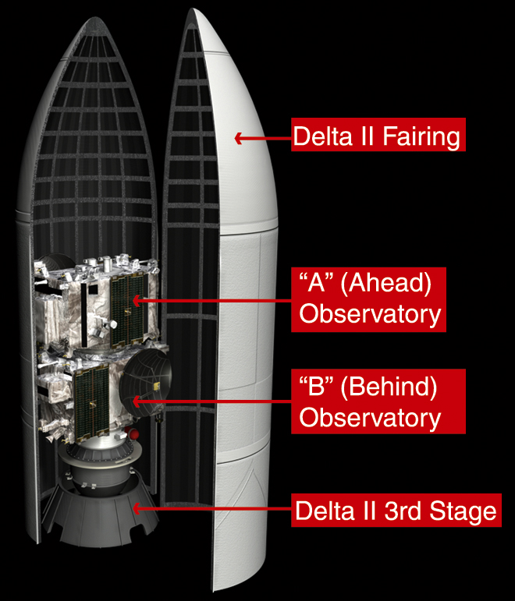
Implementation
Two nearly identical spacecraft launched by a single ELV
Bottom spacecraft in stack has adapter ring, some strengthening
Spacecraft built at Johns Hopkins University APL
Four science investigations

Slide 5
Scientific Instruments
S/WAVES - broad frequency response RF detection of Type II, III bursts
PLASTIC - solar wind plasma and suprathermal ion composition measurements
IMPACT - energetic electrons and ions, magnetic field
SECCHI - EUV, coronagraphs and heliospheric imagers (surface to 1.5 AU)

Slide 6
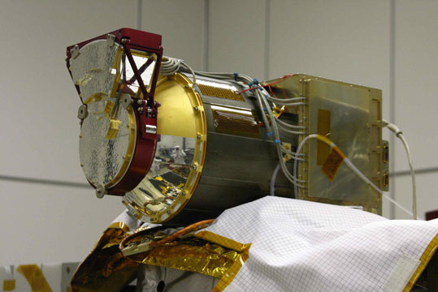
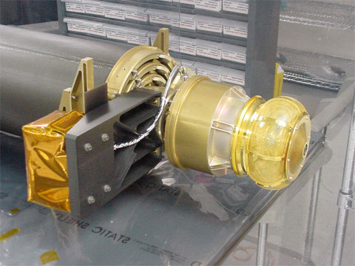
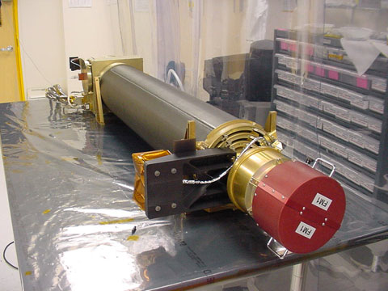
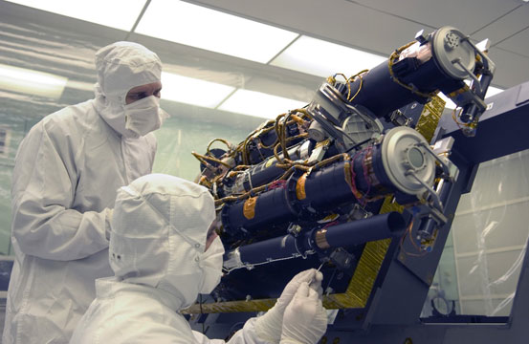
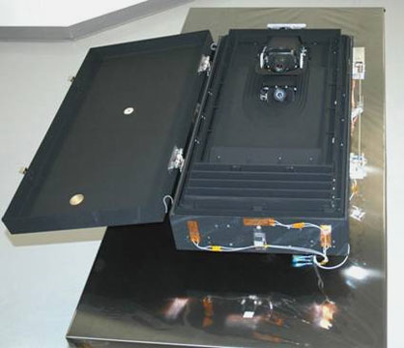
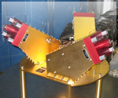
Instrument Hardware
PLASTIC IMPACT boom IMPACT boom
SECCHI SCIP SECCHI HI S/WAVES

Slide 7
Orbit Design
Science team selected a separation rate of 22° year⁻¹ from the Sun-earth line
Implemented by launching the spacecraft into slightly different phasing orbits with apogees beyond the moon’s orbit
Use moon for gravity assist to achieve heliocentric orbits with desired separation rate

Slide 8
Launch and Transfer
Spacecraft launched 2006 October 25 (26 UT)
Delta II 7925-10L from CCAFS
Ahead spacecraft transferred to heliocentric orbit 2006 December 22
Behind in heliocentric orbit 2007 January 21
To see where STEREO A and B are today, use:
http://stereo-ssc.nascom.nasa.gov/where.shtml

Slide 9
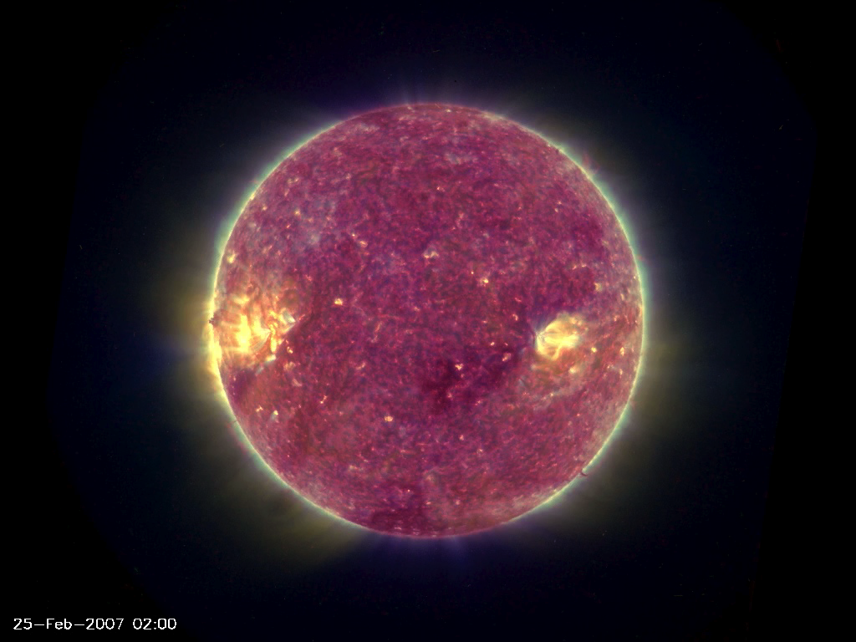
A unique view (during early heliocentric ops)
Lunar transit of the Sun, 2007 February 25

Slide 10
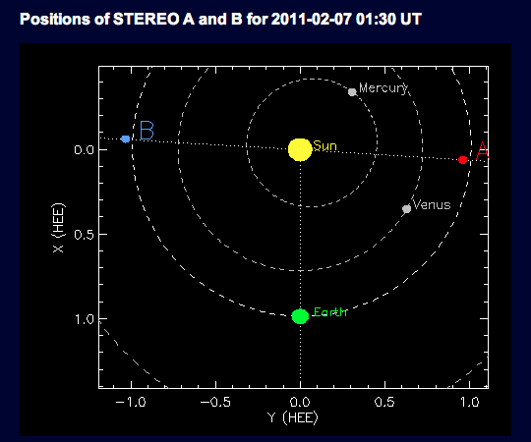
An Aside
Question: What will happen on 2011 February 6 at 7:30 PM CST?
Super Bowl XLV
STEREO spacecraft will be in opposition
B
A

Slide 11
Space Weather Information from STEREO (I)
Beacon mode
Low rate (633 bps)
Informal antenna partners
Arranged in partnership with NOAA SWPC
Currently: Bochum and Kiel (radio amateurs in Germany), Toulouse, France (CNES), Koganei, Japan (NIISC)
Don’t quite span the globe: need more!
Large gap between 139°E and 7°E
Need site(s) in Pacific, mainland US

Slide 12
Beacon mode data availability
Like all STEREO data, under the NASA Heliophysics Data Management Policy, the beacon mode data are publicly available as soon as they hit the ground and are reformatted (< 5 min.)
from the STEREO Science Center (SSC)
Images
http://stereo-ssc.nascom.nasa.gov/browse/
In situ and radio
http://stereo-ssc.nascom.nasa.gov/browse/insitu.shtml

Slide 13
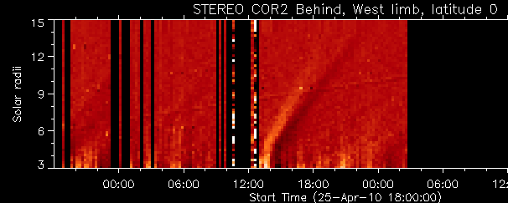
What do we get in beacon mode?
SECCHI images reduced to 256 x 256 pixels and mercilessly compressed
Subsampled solar wind and energetic particle data (PLASTIC, IMPACT)
Subsampled RF data from S/WAVES
Links to higher level beacon-mode products, such as “J-plots”

Slide 14
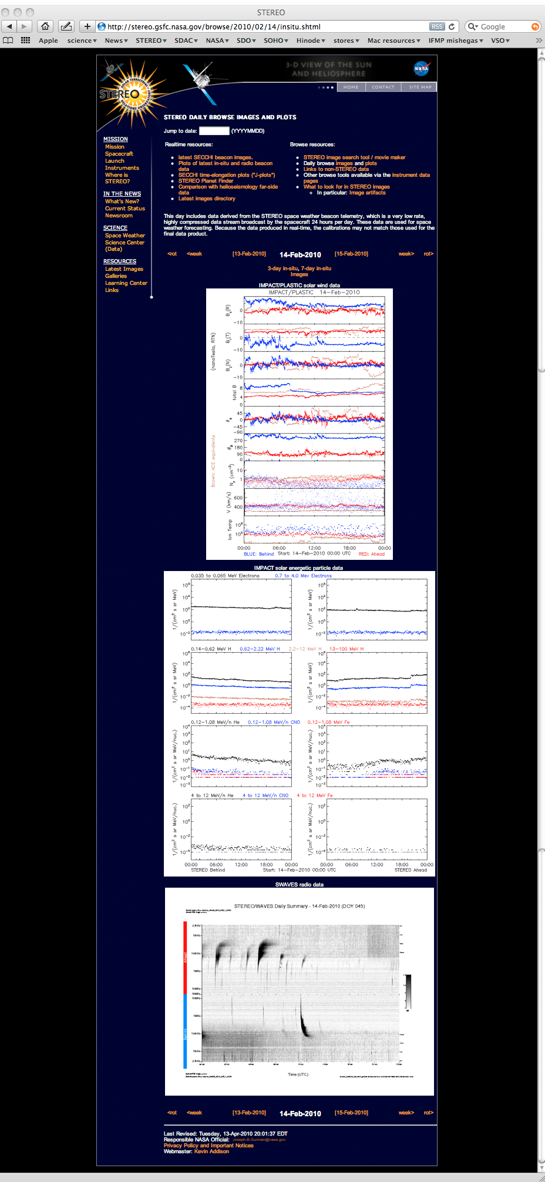
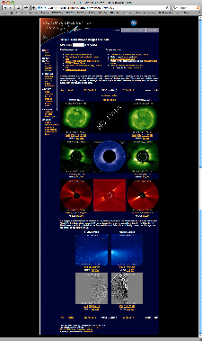
Beacon mode data
Images, links to movies
Solar wind plasma and
magnetic field data
Energetic particles
RF data (2.5 kHz - 16 MHz)

Slide 15
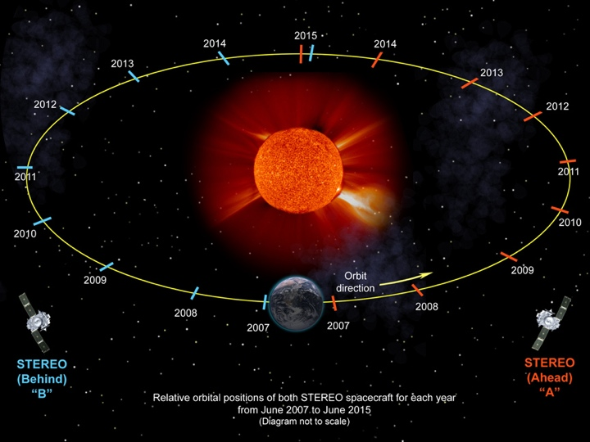
How long can we keep this up?
Spacecraft will pass one another on the far side of the Sun in 2015
Will need to rename them Abaft and Before, or something like that

Slide 16
How long can we keep this up?
Telemetry rate (kbps) | Date (Behind) | Date (Ahead)
720 | 2007/01/22 | 207/01/22
480 | 2008/09/15 | 2008/10/13
360 | 2009/09/08 | 2009/08/17
240 | 2009/12/07 | 2010/04/26
120 | 2010/11/15 | 2011/04/11
96 | 2011/09/19 | 2011/09/26
60 (?) | TBD | TBD
30 | 2012/08 | 2012/08

Slide 17
Beacon mode?
Beacon mode will need to switch to a different encoding scheme to maintain data rate with increasing distance
Will create issues with some receiving sites
Will work with NOAA SWPC to resolve
Some receiving sites may not have sufficient link margin to obtain data from ~ 2 AU

Slide 18
What have we learned?
We can model CME propagation
in 2 dimensions, geometrically
in 3 dimensions, using a forward model

Slide 19
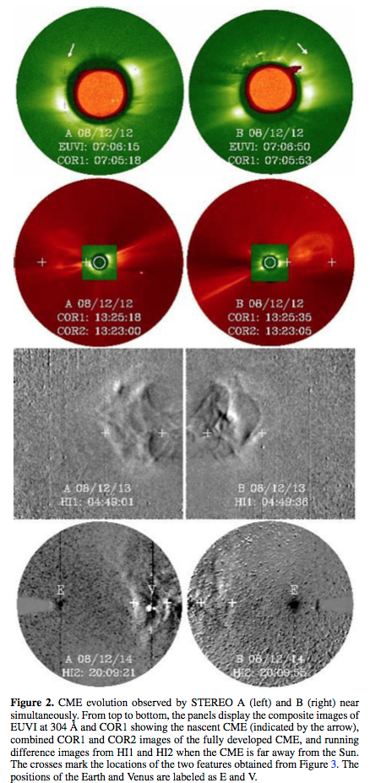
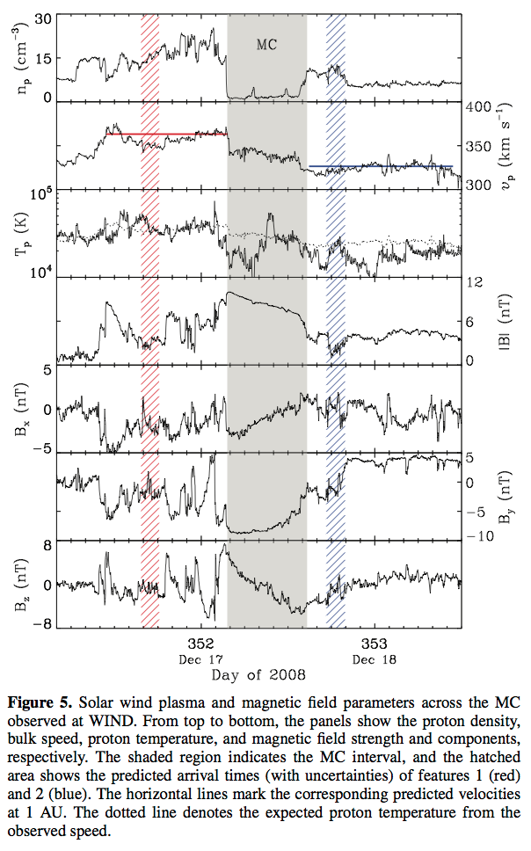
Geometric triangulation using J-maps
Liu et al. 2010, ApJ, 710, L82
Able to predict speed, arrival time of at least two features in a CME

Slide 20
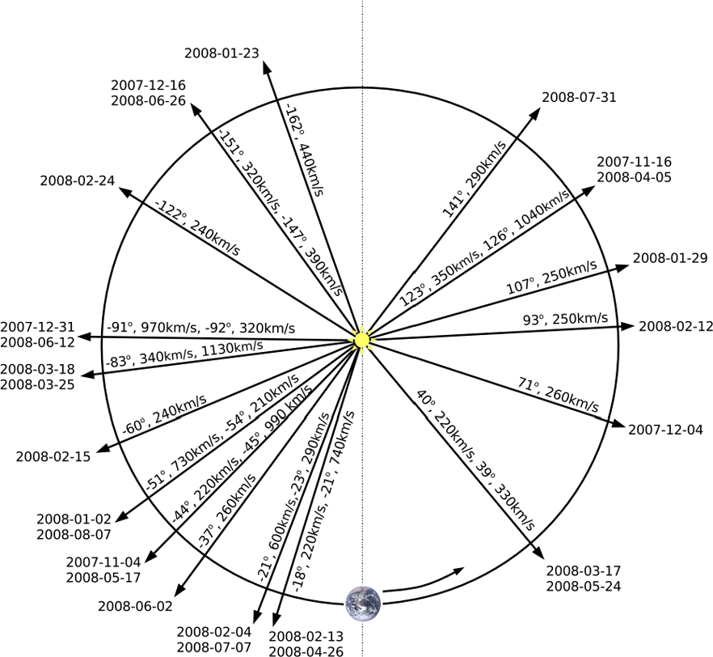
Forward modeling
Thernisien et al. 2009, Solar Phys., 256, 111
Assume flux-rope geometry
Works well for 17 events considered
Implies that nearly all CMEs are flux ropes
Can predict flux rope orientation → geoeffectiveness

Slide 21
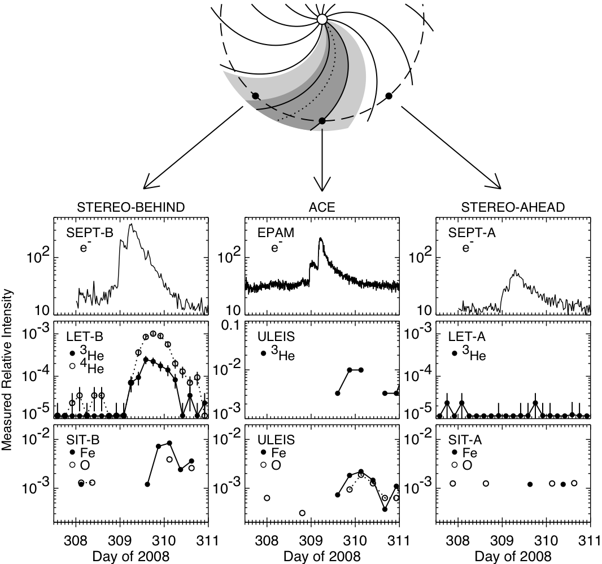
Angular extent of energetic particle events (I)
Wiedenbeck et al. 2010, Proc. 12th Solar Wind Conf.
STEREO A, B; ACE measurements show impulsive electron profile over > 80° in heliolongitude
2010/02/12 event was visible when s/c were separated by > 130°

Slide 22
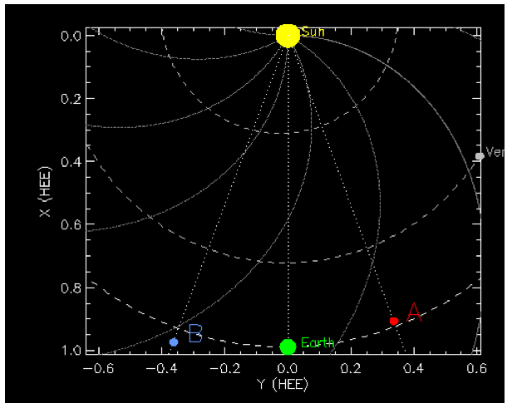
Complexity of Magnetic Cloud field (CIR interaction)
2007 November 19 - 21
Interaction of a CIR and a magnetic cloud near the heliospheric current sheet
Farrugia et al. 2010, submitted to JASTP (special CME/ICME issue)
“Double-dip” event in Dst (peak of -100 nT)

Slide 23
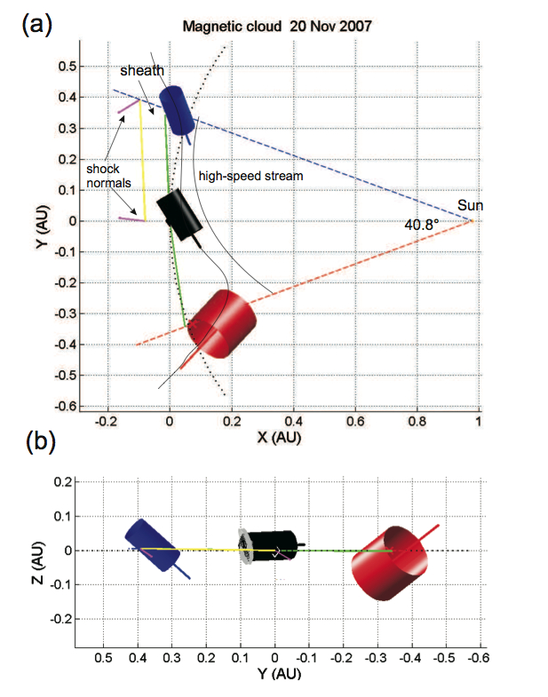
Complexity of Magnetic Cloud field (CIR interaction)
Reconstructions from three measurements (B, WIND, A) appear to show, from E to W, magnetic cloud:
after interaction with CIR
interacting with CIR, and
before interacting with CIR

Slide 24
And I’m leaving out....
Dust impacts
High-amplitude whistler waves in solar wind halo electrons
and about 300 other refereed journal articles

Slide 25
A Unique Set of Viewpoints on Solar and Heliospheric Activity
Movie sequence from all four SECCHI telescopes
on both STEREO spacecraft
2010 April 3 - 12

Slide 26
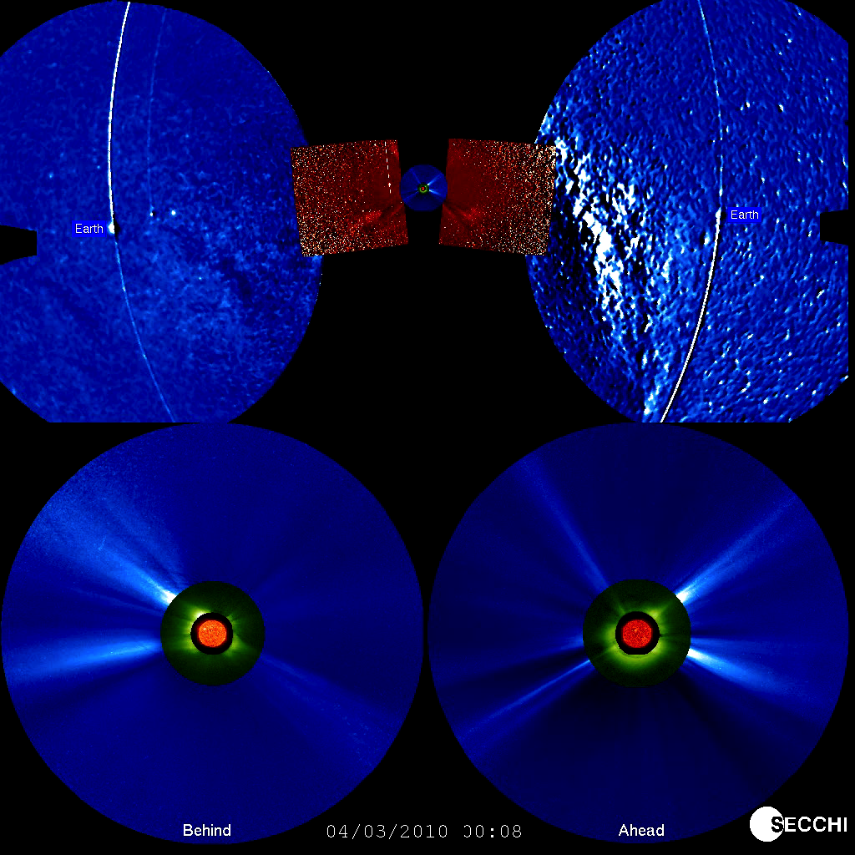
A Unique Set of Viewpoints on Solar and Heliospheric Activity

Slide 28
Full-resolution telemetry
Acquired through Deep Space Network sites only
Reformatted and available online in ~ 2 days
Longer for some higher level data products
Available from the STEREO Science Center:
http://stereo-ssc.nascom.nasa.gov/data.shtml
Includes “instrument resource pages” link

Slide 29
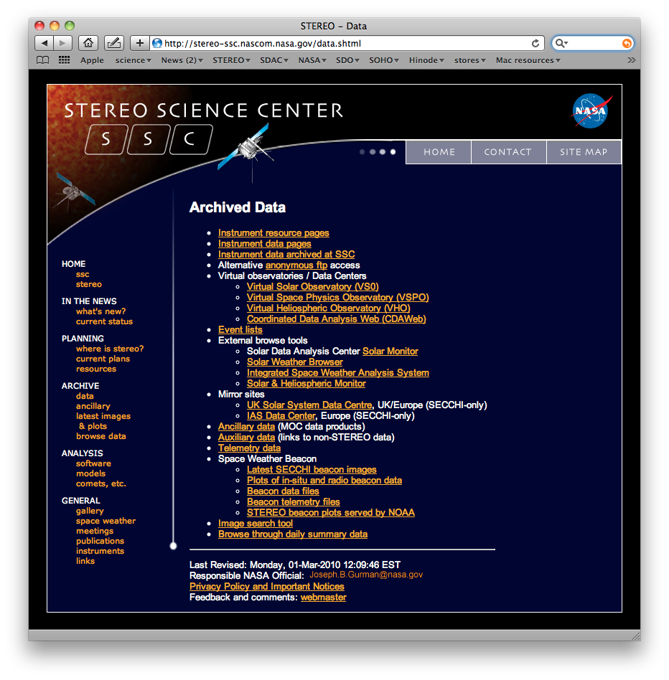
STEREO data
Instrument resource pages
Anonymous ftp access
Data at PI institutions and elsewhere
Access via virtual observatories
Ancillary data

Slide 30
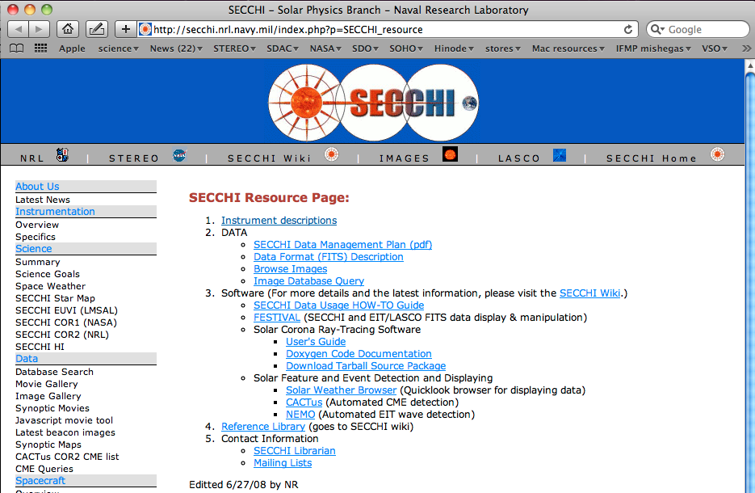
A sample “instrument resource” page (SECCHI)
File contents description
User’s guide
Contact info

