Slide 1

Twisting and Writhing with George Ellery Hale
Magnetic Helicity: from Turbulent Convection to Space Weather
Richard C. Canfield
Department of Physics
Montana State University, Bozeman
Notes:
Today I thought it would be interesting to start with a topic George Ellery Hale worked on, then move on to a more modern one.
I’m going to use the concept of magnetic helicity, which is a useful measure of the topology of magnetic fields, as a unifying framework.
The conservation of magnetic helicity UNITES what would at first irst seem to be two quite different topics, namely
The role of Helical Turbulent Convection below the Sun’s visible surface in creating twisted structures first seen by Hale, on the one hand
Solar Eruptive Events and why they lead to what we call “Space Weather” near Earth, with attendant harm to modern technologies, on the other.
More
More
More

Slide 2
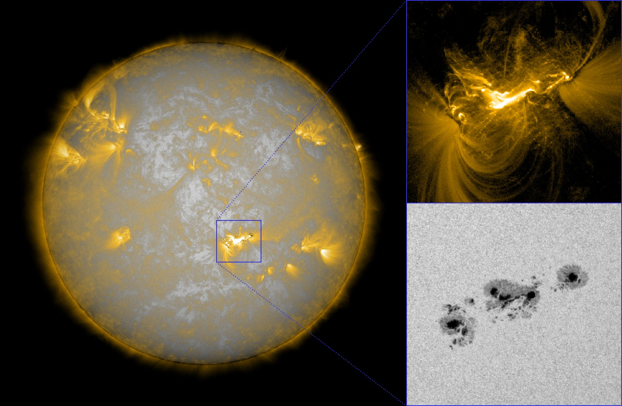
Solar Activity Context
Data courtesy of SDO Atmospheric Imaging Assembly & Helioseismic & Magnetic Imager
NOAA AR 11158 video courtesy of Daniel Brown, University of Central Lancashire
Notes:
This full-disk image of the Sun shows the outer solar atmosphere, the solar corona.
It was made with one of many multilayer filters available on the the Solar Dynamics Observatory (SDO), the flagship mission of solar physics at the present time.
The most prominent features are what we call ACTIVE REGIONS; NOAA AR 11158 is in the square, and will be featured during this talk.
(DISCUSS UPPER AND LOWER INSETS) The two insets show the active region in a high-temperature emission line (T ~ 10^6), where we see the sun’s hot atmosphere, the CORONA, and in the visible continuum (T ~ 10^4}, where we see the apparent surface, the PHOTOSPHERE.
In solar observations, particularly in the visible part of the spectrum, we have the luxury of many photons, which allows us to make videos with outstanding time resolution; such a video is shown in the next slide.

Slide 3
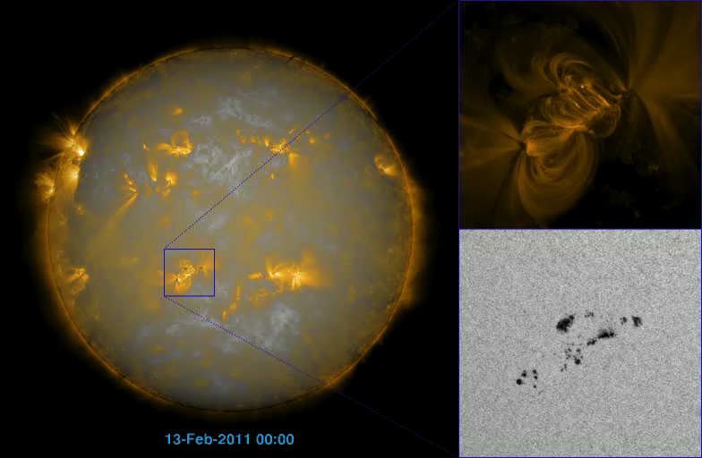
Data courtesy SDO Atmospheric Imaging Assembly & Helioseismic & Magnetic Imager
Video of AR 11158 and its context courtesy of Daniel Brown, University of Central Lancashire
Notes:
The video I will now show covers five days, as NOAA Active Region 11158 rotates across the solar disk. I suggest that you share your attention between the two insets. (START MOVIE)
In the lower right, you see the active region at PHOTOSPHERIC levels, and gradual and continuous changes in shape, size, and location of these sunspots reflect the emergence of magnetic flux from the underlying CONVECTION ZONE.
Whereas the sunspots show gradual change, the CORONA in the upper right shows the intermittent and impulsive brightenings that we call solar flares.
This DIFFERENCE in temporal behavior is your first hint that flares involve the STORAGE and SUDDEN RELEASE of energy, whereas the driver for for flares is quite CONTINUOUS AND GRADUAL.
Let’s go to the next slide, which focuses attention on the emergence of magnetic flux that is believed to be generated within and at the base of the convection zone.

Slide 4
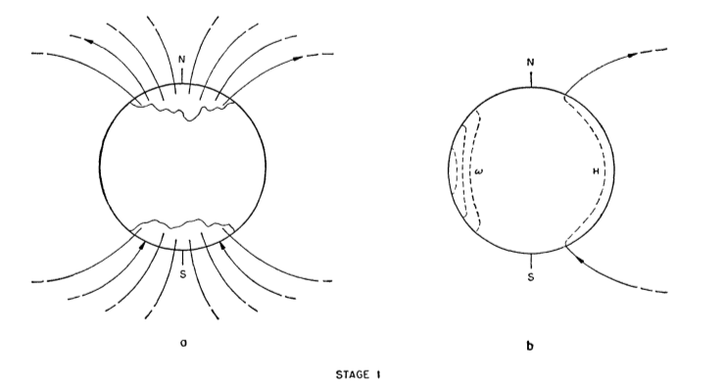
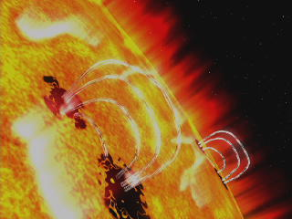
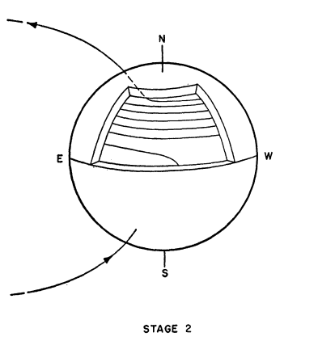
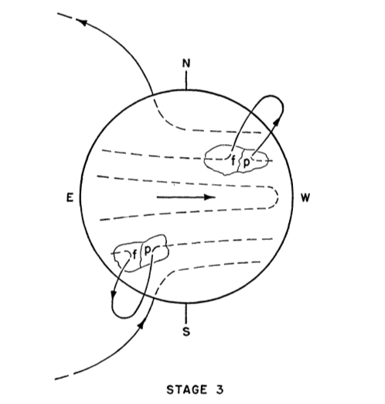
Babcock’s Dynamo Model
Key features:
Primordial field
Differential rotation in SCZ, not core
Buoyancy –› Ω loops
Ω loops –› sunspots, Active regions
H W Babcock, ApJ 1981
Notes:
Babcock’s phenomenological dynamo model contains the key features needed to understand this talk.
Primordial field is distorted by differential rotation, confined to SCZ; shear at base of SCZ creates sheet of magnetic flux, instabilities create flux tubes.
When these flux tubes become sufficiently buoyant, they rise and create what we call Omega loops and Active Regions..
The video shows an animation of these loops as they rise through the SCZ. This is just an animation; we’ll look at real data in the next slide.

Slide 5
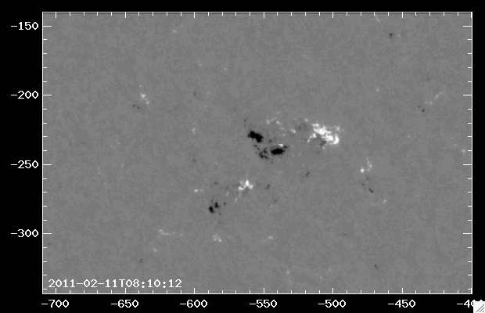
SDO Helioseismic & Magnetic Imager (HMI)
NOAA AR11158 video courtesy Lucas Tarr
Notes:
The SDO Helioseismic and Magnetic Imager allows us to image the magnetic fields of NOAA AR 11158; the x and y labels give the coordinates relative to sun center, in seconds of arc, as they appear in the sky.
In this “magnetogram” White and Black show the vertical component of the magnetic field.
The magnetic field strength has been corrected for solar rotation and viewing angle, assuming radial magnetic fields.
The video shows the effects of emergence of the Omega loops of NOAA AR 11158 over 4.4 days in February 2011.
Features to look for in the video: (1) the black polarity feature on the lower left shows interesting rotational motion, a manifestation of twist in the Omega loops: (2) shearing motions between black and white polarity, which are relevant to the second topic of the talk, namely mutual helicity and eruptions; (3) features tend to be smaller first, larger late, which we will interpret in a minute; (SHOW FEATURES IN VIDEO).
In the next slide, we will see the implications of the LAST of these three properties: smaller first, larger later.

Slide 6
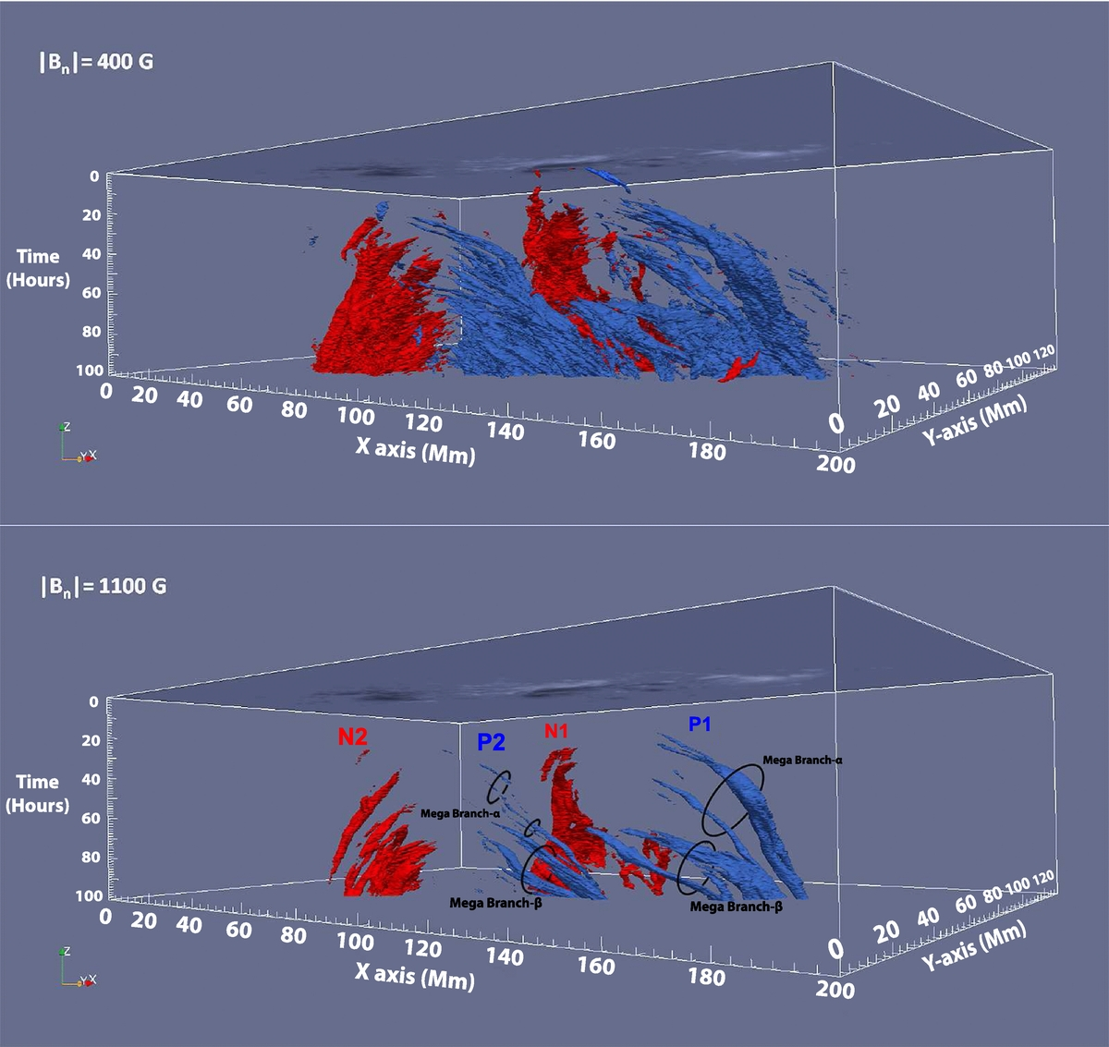
Inferring Subsurface Structure
Stack 800 HMI magnetograms
1 mtgm every 7.5 min for 100 hours)
Red / blue: negative / positive polarity
Assume structure is rigid, rises with constant velocity
Chintzoglou and Zhang ApJ 2013
Notes:
(READ BULLETS)
(EXPLAIN AXES, MAGNETOGRAM ON ROOF, 400 & 1100 ISOGAUSS LEVELS, BRANCHES)
In the next slide, we relate the motions in the magnetogram to inferred structure of the Omega loops.

Slide 7
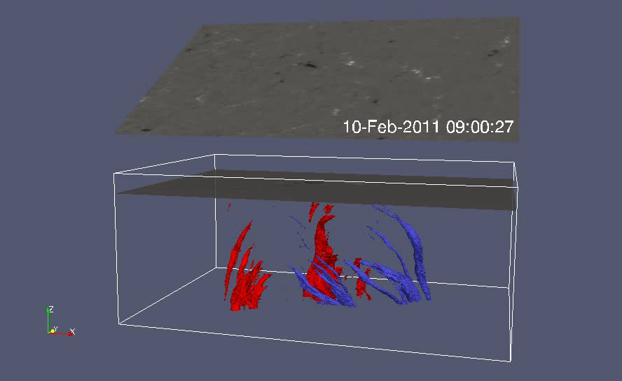
Chintzoglou and Zhang ApJ 2013
Notes:
What should we conclude from this structure? Omega loops rising through the convection zone have a tough life!
The force of buffeting by convective turbulence is sufficiently great that it actually shreds the Omega loops.
Studies of flux fragments show their size distribution function has lognormal form, which implies that repeated random bifurcation dominates fragmentation and coalescence.
The implication of the branches is that the structures start out as a single Omega loop and are shredded by turbulent convection.
This occurs because the Solar Convection Zone dynamics are dominated by gas-pressure forces, not magnetic forces.
In the next slide, let’s talk about a discovery that George Ellery Hale made when he developed innovative solar instrumentation that allowed him to image the Sun’s magnetically dominated atmosphere, above the visible surface.

Slide 8
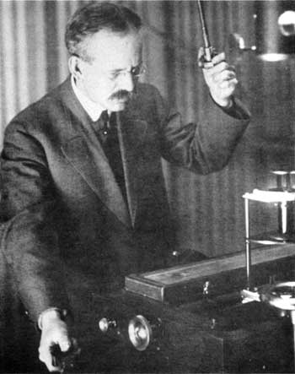
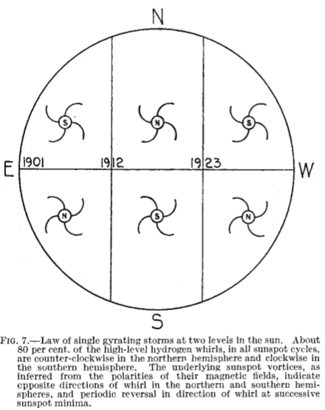


Hale’s “Vortices (1908)”
Vortex direction depends on hemisphere
Vortex direction does not depend on cycle
Hale used Hα, so he saw the magnetically dominated solar chromosphere, where β = p_{g}/p_{B} < 1, unbeknownst to him.
Hale, ApJ 1927
Northern Hemisphere
(left handed upwelling)
Southern Hemisphere
(right handed upwelling)
?
Notes:
1888: Hale invented an instrument called a spectrohelioscope while he was a student at MIT.
This instrument enabled monochromatic imaging in H-alpha, showing a new and unexplored region of the solar atmosphere.
1908: Hale upgraded SHG -> MTG -> Sunspots are magnetic, E-W alignment
1908: Hale discovered sunspot vortices, which he thought were analogous to cyclones on Earth
(EXPLAIN HALE FIGURE, BULLET POINTS)
(EXPLAIN CORIOLIS FORCE AND GLATZMEIER FIGURES)
Why the ? In this slide? Because we NOW know that the patterns in the CHROMOSPHERE reflect MAGNETIC FIELDS, NOT FLOWS.
Moreover, as I will show in a few minutes, Hale was on the right track, but the vortex structures originate in the gas-pressure dominated SCZ, not in the magnetically dominated chromosphere ,
At this point in the talk we must pause to review the physics that governs the dynamics of magnetized gasses: magnetohydrodynamics (MHD)

Slide 9
Magnetohydrodynamics:
Fluid Dynamics + Electromagnetism
Mass conservation
Momentum conservation
Internal energy conservation
Faraday’s equation
Ampere’s law
Gauss’s law
Ohm’s law
Equation of state
B, v, p, ρ
Notes:
(READ THROUGH CONTENTS OF BOX)
Faraday’s equation relates the electric field to the rate of change of the magnetic field.
Ampere’s law relates the current density to the curl of the magnetic field.
Gauss’s law says that the divergence of the magnetic field is zero.
Ohm’s law says that the electric field in a frame moving with the matter is proportional to the current.
The equation of state relates pressure, temperature, and density.
These equations can be combined and simplified to reduce the unknowns to the vector magnetic induction (B) and vector gas velocity (v) and scalar pressure (p) and mass density (rho).

Slide 10
Magnetohydrodynamics:
Magnetic Helicity + Force-Free Fields
“We then, by the way, find … that
A • B is a constant of the motion.”
Elsasser, Rev Mod Phys 1956
where
-------------------------------------------------------------------------
Minimizing
where α is a Lagrange multiplier, leads to the equation
for “force-free” ( j x B = 0 ) fields.
N.B.: α is a measure of twist (constant when E is minimum).
Woltjer, Proc Nat Acad Sci 1958; Berger, AGU Geophys. Mon. 111, 1999
Notes:
Now let’s talk about magnetic helicity, which you will remember from the subtitle of this talk.
(GO THROUGH THE SLIDE, MENTIONING THE CONCEPT OF A FLUX SYSTEM)
Note that although the photosphere is not force-free, alpha is a convenient measure of twist, and we can relate it to Hale’s vortices.
Describe how to compute alpha from observations of the magnetic field vector.

Slide 11
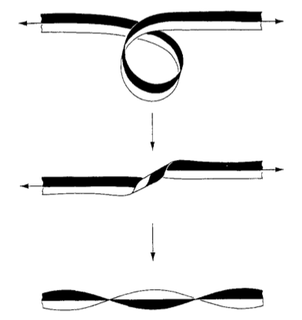
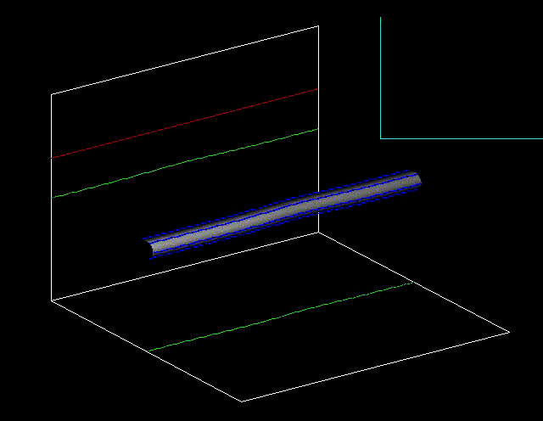
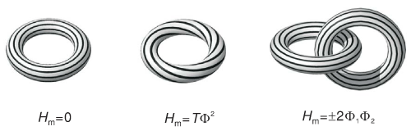
Twist, Writhe, Linking, Self & Mutual Helicity and Conservation
Writhe
(W)
Magnetic
Helicity
Conservation
H_{m} = T + W
Twist
(T)
Moffatt & Ricca Proc. R.
Soc. Lond. A, 1992
Video courtesy of Dana Longcope
N N
H_{m} = Σ Σ L_{ij} Φ_{i} Φ_{j}
i=1 j=1
L_{ij} : Linking Number
i = j : Self Helicity
i ≠ j : Mutual Helicity
Wiegelmann & Sakurai LRSP
Notes:
The upper part of the slide shows Writhe, Twist and the conservation of helicity in a purely geometric context (think of a paper ribbon or a garden hose). (DISCUSS GARDEN HOSE)
The lower part of the slide shows four toroidal magnetic flux tubes, each with magnetic flux Phi. Self helicities H_ii measure linking within the same tube. Mutual helicities H_ij measure linking with different tubes. Note that the left-most torus has T = 0 and the center torus is twisted by T = 1 turn. Moreover T = +1 by convention, because the field is right-handed.

Slide 12
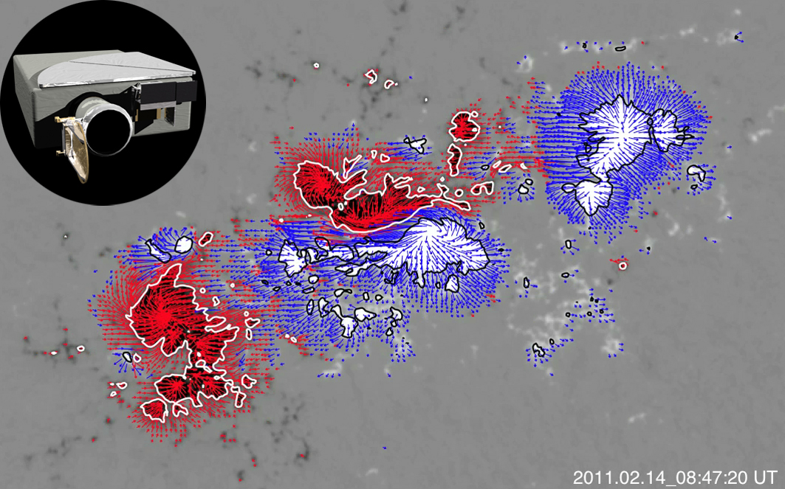
Hale’s Vortices in Modern Data:
SDO/HMI Vector Magnetogram
SDO Helioseismic & Magnetic Imager
Notes:
In this slide we see what we call a vector magnetogram: the magnitude and sign of the vertical component of B is shown in black and white (as on previous slides) and the magnitude and direction of the horizontal component of B is shown by the length and direction of arrows that are color-coded blue and red for upward and downward B.
Vector magnetograms are based on both circular and linear polarization measurements. The transverse component comes from linear polarization, whose magnitude is typically and order of magnitude less than circular polarization. Only in the last few decades, long after Hale, has meaningful measurement of linear polarization matured (and some people still dicker).
(POINT OUT VORTICES OF BOTH SENSES IN BOTH POLARITIES: MESSY!)
At each point in the vector magnetogram calculate alpha = curl B over B, then do a fit in a least-squares sense to the Active Region as a whole. Ten- to twenty years ago this was done for datasets consisting of hundreds of Active regions. The next slide shows the result.

Slide 13
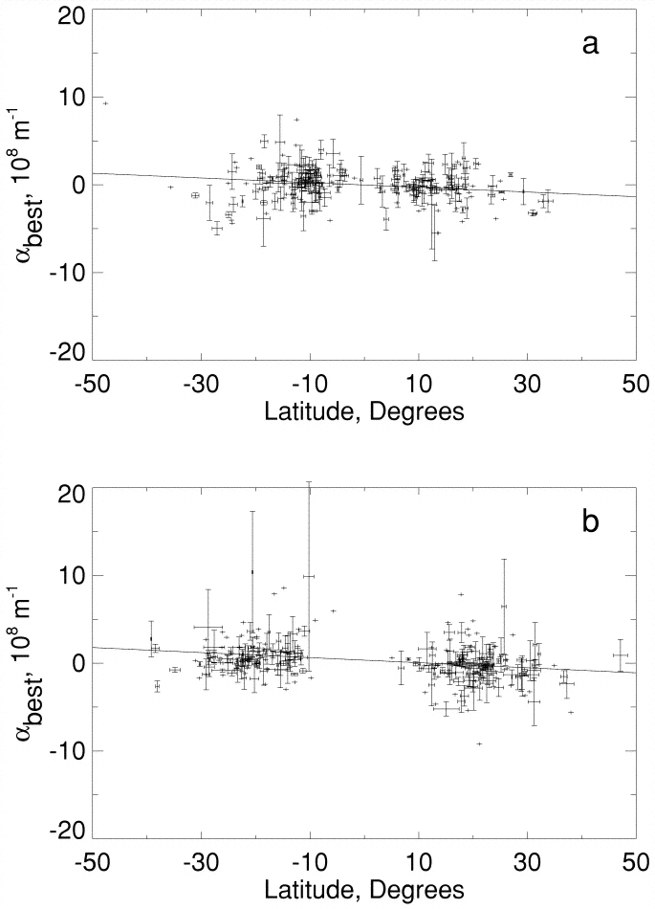
Hale’s Vortices Today:
The Hemispheric Twist Rule
Solar Cycle 22
203 Active Regions
Solar Cycle 23
263 Active Regions
Pevtsov, Canfield, Latushko ApJ 2001
Notes:
The “Hemispheric Twist Rule” says that active region magnetic fields tend to have overall twist that is left-handed in the Northern Hemisphere and right-handed in the Southern.
In both scatter plots, the x axis is latitude, with North on the right, and the y axis is the best-fit active-region alpha value, a measure of twist. Each point is one active region. The error bars show the range of alpha values when the AR was observed more in more than one magnetogram.
There are three basic results:
First the hemispheric dependence : α is negative in the North, positive in the South (recall Hale’s vortices)
Second, the cycle dependence: the hemispheric helicity rule does not depend on cycle (again, recall Hale’s vortices)
Third, the scatter is real: the values are much better determined than the apparent scatter.
The importance of the modern measurements relative to Hale’s is that they are quantitative, and both the measured slope of the fit , given by the line, and the scatter from one region to the next, given by the error bars, contain useful information, whose meaning is explored on the next slide.

Slide 14
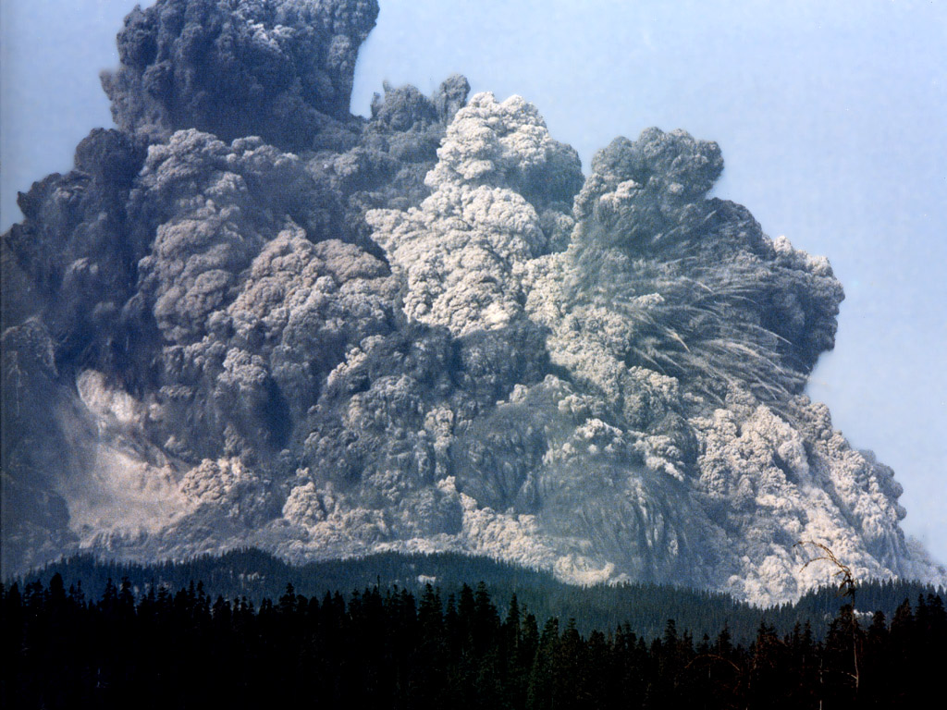
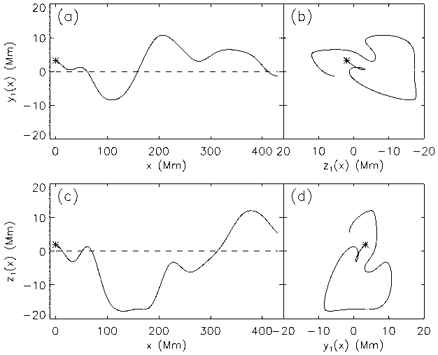


Flux-Tube Twist from Helical Convective Turbulence
Σ Effect Model:
Horizontal thin flux tube
Helical convective turbulence
Mixing length theory, velocity
Monte Carlo approach
Conservation of helicity
National Geographic / Universe Today
Northern
hemisphere
Southern
hemisphere
Glatzmaier ApJ 1985
Longcope, Fisher, Pevtsov ApJ 1998
Notes:
As the frames on the left-hand side of this slide illustrate, a rising Omega loop feels two important effects: TURBULENCE and HELICAL MOTIONS
Ir is very plausible that turbulence plays an important role, given the shredding of Omega loops near the surface that I showed earlier
Hale plausibly thought his vortices were due to helical motions; today, we place them in the solar convection Zone, not the atmosphere.
DISCUSS LHS OF SLIDE
Longcope, Fisher and Pevtsov (1998) have provided what I think is the most compelling modeling of the physics in the Sigma-Effect Model
DISCUSS RHS OF SLIDE

Slide 15
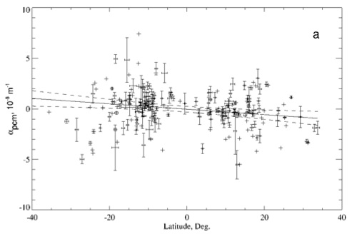
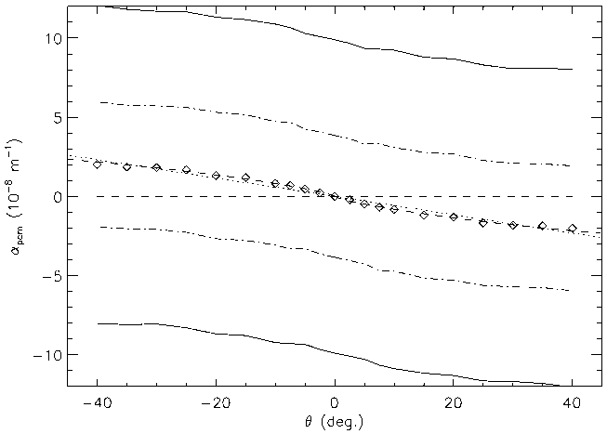
Flux-Tube Twist Resulting from Convective Turbulence
Pevtsov Canfield Metcalf 1996 ApJ
Longcope Fisher Pevtsov 1998 ApJ
The Σ Effect Model works: Coriolis force + convective turbulence + helicity conservation ➔ North/South -/+ twist, no solar cycle dependence, intrinsic scatter.
Notes:
The left figure of this slide shows the observational evidence for the hemispheric helicity rule as of the late 1990s. The right figure shows the predictions of the Sigma-Effect Model for a typical Omega-loop flux of 3 x 10^21 Mx.
A you can see, the Sigma Effect Model successfully explains the hemispheric dependence, the cycle dependence, and the scatter

Slide 16
“THE SOLUTIONS ALL ARE SIMPLE …
AFTER YOU’VE ALREADY ARRIVED AT THEM.
BUT THEY’RE SIMPLE ONLY WHEN
YOU ALREADY KNOW
WHAT THEY
ARE”
Robert M. Pirsig
Zen and the Art of Motorcycle Maintenance
Notes:
When I was preparing this talk, I was reading Robert Pirsig’s “Zen and the Art of Motorcycle Maintenance”, because I only recently learned of the Bozeman connection in this famous book, yet I had never read it.
The book includes this quote, which describes how I felt when I became aware of the importance of the conservation of magnetic helicity in the explanation of the hemispheric twist rule.
In the next slide, we turn to another application of helicity conservation: the relationship between eruptive events on the Sun and the properties of the space environment near Earth: what we call SPACE WEATHER.

Slide 17
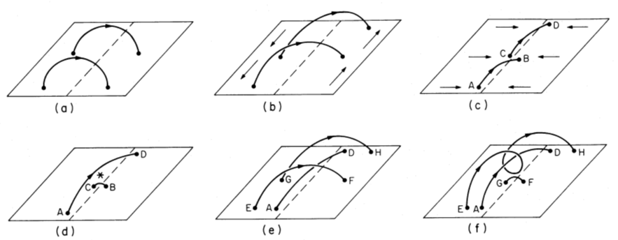
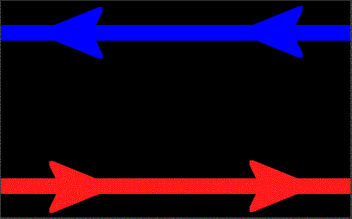
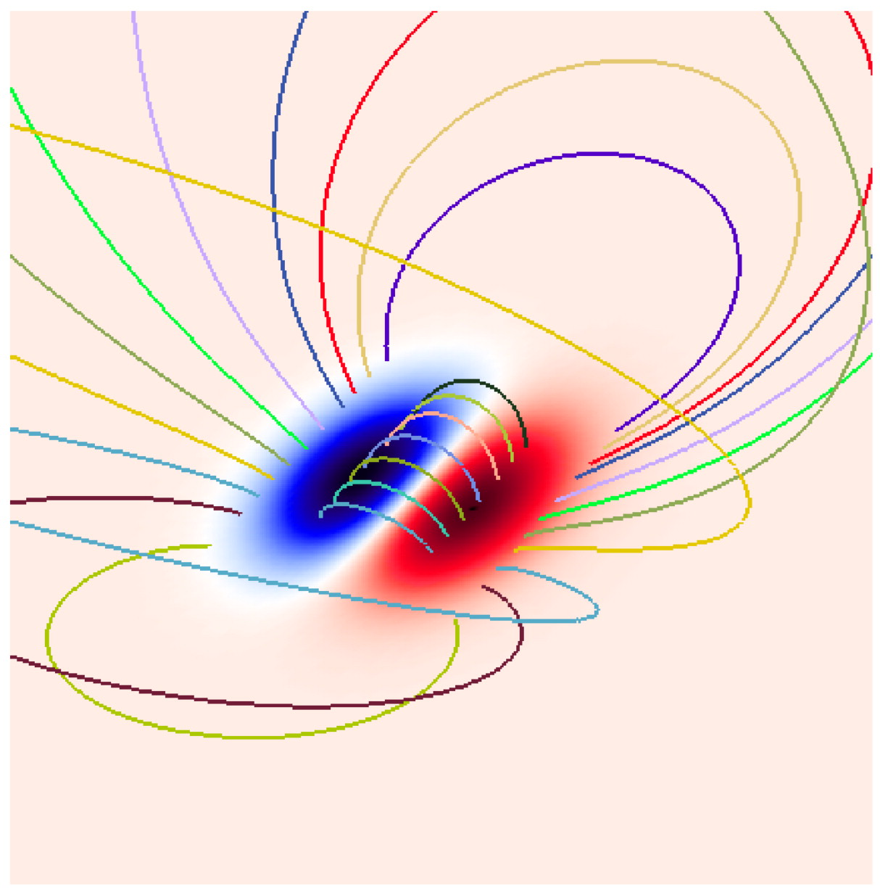
Flux Rope Formation: Photospheric motions & Magnetic Reconnection
Figures courtesy M Berger, D Longcope
van Ballejooijen & Martens ApJ 1989
Reconnection + Helicity Conservation
Mutual Helicity → Self Helicity
Notes:
FLUX ROPES are important to, and common in, many aspects of solar activity. This slide shows two cartoons that illustrate one of several scenarios in which flux ropes are plausibly formed driven by PHOTOSPHERIC MOTIONS (like we have seen earlier in the talk) and MAGNETIC RECONNECTION:
a. creation of mutual helicity from initially potential fields (a) through shearing motions (b) across a active region PIL and
c. convergence toward the PIL driving MAGNETIC RECONNECTION at * (c,d)
e. repetition of the process involving overlying magnetic field lines (e,f).
In the next slide we leave the land of cartoons to see such of motions, reconnections, and FLUX ROPE FORMATION in a proper 3D NUMERICAL SOLUTION of the equations of MHD.

Slide 18
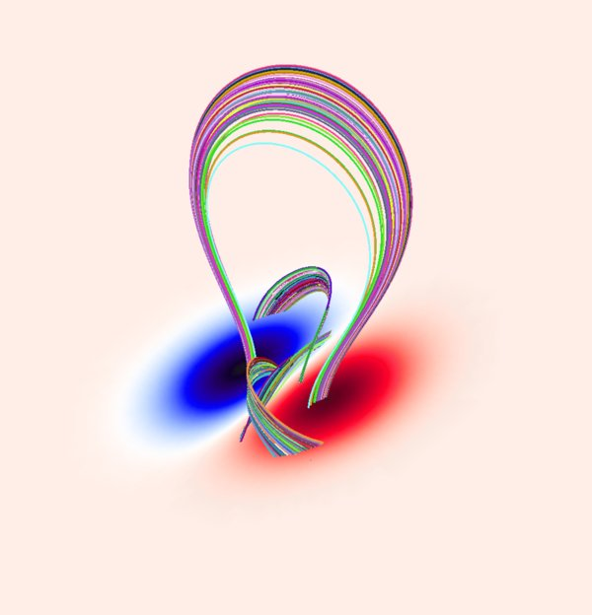
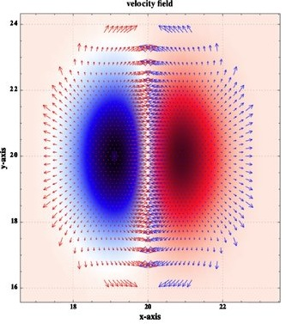
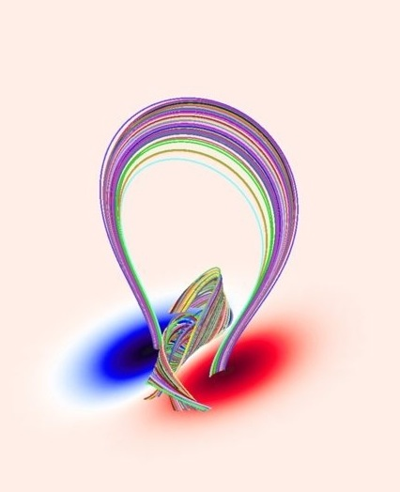
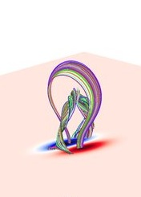
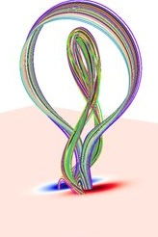
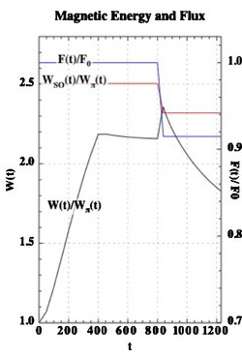
MHD Numerical Simulation
Amari, Aly, Mikic, Linker ApJ L 2010
Notes:
The red and blue patches are the active region positive and negative magnetic field regions in the photosphere. This temporal sequence shows the consequences of shearing and converging motions, idealized versions of what I showed in the earlier SDO magnetogram videos to illustrate the effects of emerging flux shredded by convecttion.
(CLICK ON EACH PANEL TO DISCUSS EACH STAGE)
On the next slide we see the observational phenomenon that we associate with erupting flux ropes: a Coronal Mass Ejection , or CME

Slide 19
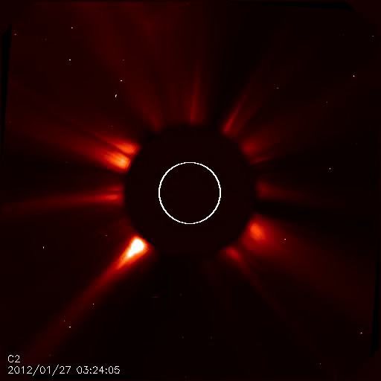
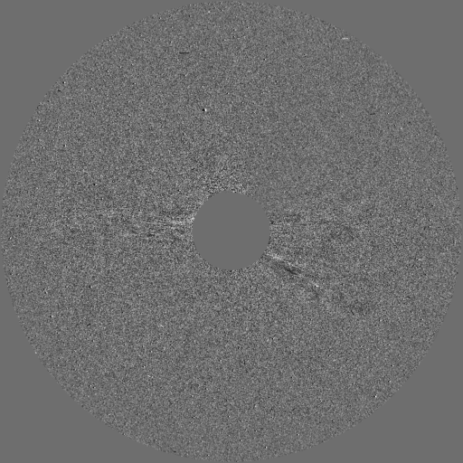
Coronal Mass Ejections
(CMEs) Are Flux Ropes
Vourlidas et al ApJ 2012
Courtesy of Ben Lynch
Notes:
The LEFT-HAND PANEL shows a sequence of images obtained by the LASCO coronagraph on the SoHO mission. The bright solar disk is occulted; it’s size is indicated by the white circle. This is a classic CME: as it erupts, you see a bright central structure that is associated with a flux rope (SHOW LHS VIDEO)
The RIGHT-HAND PANEL shows another LASCO coronagraph video, but this time rather than a SIMPLE SEQUENCE of images, it is a running-DIFFERENCE between successive images, which enhances subtle moving structures. The “slinky” structure is obvious. (SHOW RHS VIDEO).
In the last few years, it has become increasingly clear that, in all likelihood, all CMEs are flux ropes.

Slide 20
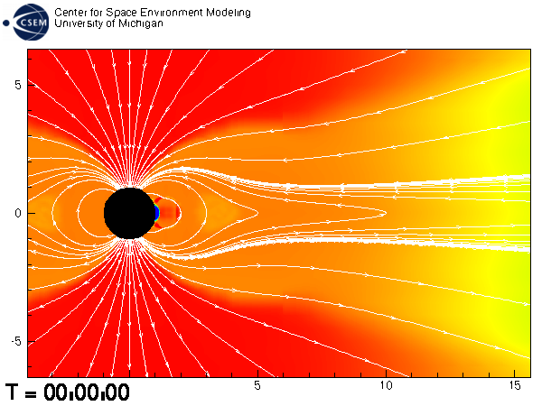
Notes:
Here is an MHD simulation of a flux rope propagating from Sun to Earth, using an amazing re-gridding algorithm to deal with the huge range of scales.
In this simulation a simple toroidal flux rope is inserted, becomes distorted into a pancake in the ecliptic plane, and in about 3 days encounters the Earth’s magnetosphere.
For reasons that you will recognize, it reminds me of the famous “Powers of Ten” video we use in elementary astronomy classes.
At the present time it’s not realistic to use such MHD simulation methods to do the coronal flare topology and interplanetary propagation in real time with real data like the photospheric magnetic field movies I showed earlier.
(NEXT SLIDE)

Slide 21
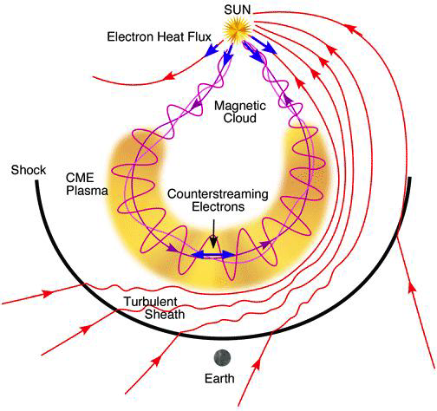
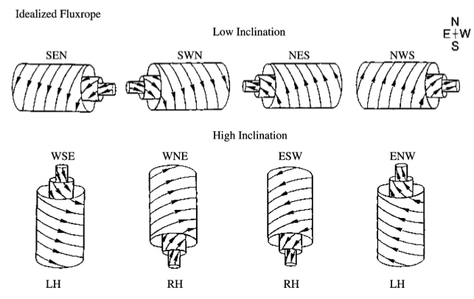
The Space Weather Challenge for the helicity enthusiast:
Predict the leading-field orientation when these flux ropes arrive at Earth – predict the Magnetic Cloud helicity
The most severe space weather is associated with flux ropes
whose leading magnetic field points South (opposite Earth),
pushing a sheath magnetic field that also points South.
Notes:
In modern space science, the understanding of solar effects on the earth’s magnetosphere and satellite systems (e.g. GPS, cell phones) in space near Earth has become particularly important; in NASA program jargon, as well as reality, we are LIVING WITH A STAR.
(EXPLAIN SLIDE)
(NEXT SLIDE)

Slide 22
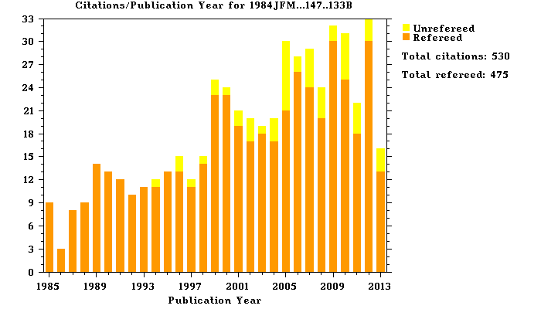
Energy and Helicity Flux from Magnetogram Sequences
Berger & Field (JFM 1984)
Finn & Antonsen (CPPCF 1985)
November & Simon (ApJ 1988)
Chae et al (ApJL 2001)
Kusano et al (ApJ 2002)
Demoulin & Berger (SP 2003)
Notes:
During the last 20 years, in Solar Physics, magnetic helicity has grown from a theorist’s plaything to an observable physical quantity.
Major advances along the way have been made in several seminal papers, starting with Berger and Field in 1984 … (EXPLAIN SLIDE)
As these two equations show, what you need In order to determine the HELICITY AND ENERGY FLUXES from photospheric magnetogram sequences are the normal and tangential components of velocities and magnetic fields at the level of measurement.

Slide 23
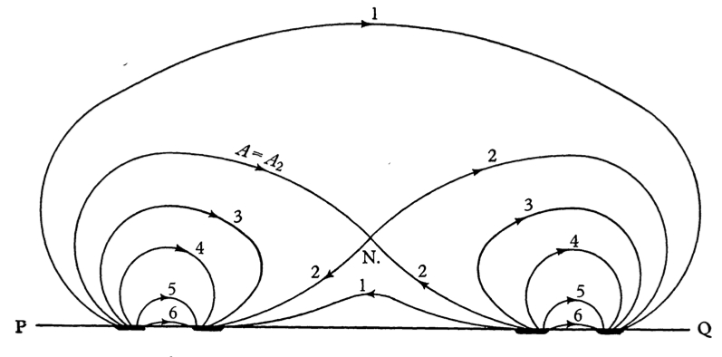
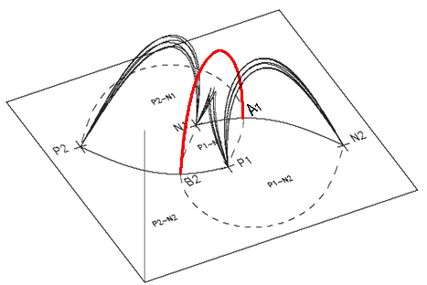
Energy and Helicity Storage in Active Region Coronae
MINIMUM CURRENT CORONA (MCC)
Separators are “fault lines” in the topology of the corona, where magnetic reconnection can take place.
Topology changes only when flare reconnection occurs and/or when flux emerges or submerges.
Currents build along separators in the corona, with no dissipation, until flare reconnection occurs.
When flare reconnection occurs, full dissipation of those separator currents accounts for flare Energy and Helicity
Physics: Faraday’s Law, Ohm’s Law, separator current self-inductance.
The MCC predicts E and H stored on all separators; use observations to identify which of them flare and the value of their reconnection flux.
Sweet IAU Symposium 6,1958
Courtesy of Dana Longcope
Notes:
An interesting and useful model of ENERGY AND HELICITY STORAGE in the corona has been developed by my MSU colleague Dana Longcope. The idea of the model is to represent fragments of flux like we see in the SDO HMI movies by point magnetic charges so you can calculate separators. The point magnetic charges move around and transport ENERGY and HELICITY through the photosphere into the corona, following the equations in the previous slide, where energy and helicity build up until reconnection occurs.
Remember the movie I showed at the very beginning of this talk, on the context of NOAA AR 11168? Remember how the motions of the emerging magnetic field were smooth, whereas the energy release in flaring was highly intermittent and impulsive? That’s got ENERGY STORAGE written all over it!
A simple summary of the model is in this slide. (READ THROUGH THE SLIDE, USING THE SIMPLE 2D AND 3D PICTURES).

Slide 24
Predicted (MCC) & observed (SDO/EVE, ACE) MC helicity and flare energy, 4 eruptive events
Kazachenko, Canfield, Qiu & Longcope. 2010
Notes:
In these figures we test the ability of the MCC model to successfully predict the observations for four flares of varying GOES X-ray flux.
In the LEFT-HAND PANEL, we see the flaring separators helicity on the Y axis and the observed X-ray flux on the X axis. As on the left, the prediction of the MCC model is shown in red and the Magnetic Cloud helicity fits to the ACE data are shown in green. The large uncertainties are due to the uncertainty about how twist is distributed along the axis of the Magnetic Cloud.
In the RIGHT-HAND PANEL, we see radiative energy output on the Y axis and observed X-ray flux on the X axis. The prediction of the MCC model is shown in red, and the TOTAL SOLAR IRRADIANCE observation from the SDO EVE instrument is shown in purple. You can see that the predictions are within 1-sigma for all but the weakest flare.
It is interesting that the model, which attributes all released energy and helicity to what is stored on the flaring separators, and ignores large-scale currents elsewhere in the active regions, works so well.

Slide 25
Summary
The conservation property of magnetic helicity makes it a very useful quantity:
Links turbulent motions in the solar convection zone to stresses in solar active region magnetic fields.
Links the storage of energy and helicity in active regions to magnetic reconnection, flux rope formation, and Space Weather.
Together these processes link the solar dynamo and convection zone to eruptive solar events and their interaction with the magnetic field of Earth.
Notes:
In summary: (READ SLIDE)

Slide 26
Thanks
Thanks to the Solar Physics Division for honoring me with the Hale Prize
Thanks to you for your attention
Notes:
Thanks to the Solar Physics Division honoring me with the Hale Prize
Thanks to you for your attention

Slide 27
PhD Students
Richard C. Puetter, Ph.D. (Physics), University of California, San Diego, 1980
Paul J. Ricchiazzi, Ph.D. (Physics), University of California, San Diego, 1982
Todd A. Gunkler, Ph.D. (Physics), University of California, San Diego, 1984
George H. Fisher, Ph.D. (Physics), University of California, San Diego, 1984
David H. Tamres, Ph.D. (Physics), University of California, San Diego, 1989
Kenneth G. Gayley, Ph.D. (Physics), University of California, San Diego, 1990
Thomas R. Metcalf, Ph.D. (Physics), University of California, San Diego, 1990
Kimberly D. Leka Ph.D. (Astronomy), University of Hawaii, Honolulu, 1995
Angela C. Des Jardins, Ph.D. (Physics), Montana State University, Bozeman, 2007
Maria D. Kazachenko, Ph.D. (Physics), Montana State University, Bozeman, 2010

Slide 28
Postdoctoral Fellows
Chang-Hyuk An, Ph.D. (Physics), University of Tennessee, 1979
Stanley Owocki, Ph.D. (Physics), University of Colorado, 1981
Jean-Pierre Wuelser, Ph.D. (Physics), University of Bern, 1988
Thomas R. Metcalf, Ph.D. (Physics), UCSD, 1990
Jean-Francoise de La Beaujardiere, Ph.D. (Astrophysical, Planetary, and Atmospheric Sciences), University of Colorado, 1990
Edward Lu, Ph.D. (Physics), Stanford University, 1990
Gianna Cauzzi, Ph.D. (Astronomy), University of Florence, 1992
Alexei Pevtsov, Ph.D. (Solar and Planetary Physics), Institute of Solar-Terrestrial Physics, Irkutsk, 1992
Tetsuya Magara, Ph.D. (Solar Physics), University of Kyoto, Japan 1998
Robert Leamon, Ph.D. (Physics), University of Delaware, Newark, 1999
Stephane Regnier, Ph.D. (Physics), Institute d'Astrophysique Spatiale, Orsay, 2001
Dibyendu Nandi, Ph.D. (Physics), Indian Institute of Science, Bangalore, 2003

Slide 29
Research Experience for Undergraduate Students
Robert Stencel, University of Michigan
Marc Allen, University of Michigan
James Rhoads, Harvard University
Keith Lambkin, University College Dublin
Tanya Freeman, Union College
Ji Son, University of California, Los Angeles
Crystal Fordyce, Clemson University
Emily McLinden, University of Chicago
Scott Waitukaitis, University of Chicago
Michael Hahn, Cornell University
Stacy Gaard, University of Indiana
Alexander Russell, University of St Andrews
Thomas Schad, University of Notre Dame
Christopher Lowder, Georgia Institute of Technology
Meghan Cassidy, University of Maryland
William Simpson, University of St. Andrews

Slide 30
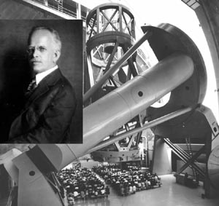
Finis
Journey to Palomar, Todd & Robin Mason
Notes:
Thank you for being a great audience

